Slide 1
Java Programming
Java Programming IT-11

Slide 2
Methods in Java
In Java, methods are blocks of code that perform specific tasks or functions. Methods are defined within classes and can be called or invoked to perform their tasks. Here's a basic overview of how to define and use methods in Java:
You declare a method within a class using the following syntax:
< access_modifier > < return_type > < method_name > ( < parameter_list > ) {
// method body
}

Slide 3
Methods in Java
<access_modifier>: Specifies the visibility of the method (e.g., public, private, protected, or package-private).
<return_type>: Specifies the data type of the value that the method returns. Use void if the method doesn't return a value.
<method_name>: The name of the method.
<parameter_list>: A list of parameters (input values) the method accepts, enclosed in parentheses. If the method doesn't take any parameters, use empty parentheses ().

Slide 4
Methods in Java
Method Body:
The method body contains the actual code that defines what the method does. It is enclosed in curly braces {}.
Method Invocation:
To use or call a method, you need to invoke it from another part of your program.You do this by specifying the method name followed by parentheses and passing any required arguments inside the parentheses(if the method accepts parameters).

Slide 5
Methods in Java
public class MyClass {
// Method definition with no parameters and returning an integer
public int addNumbers() {
int a = 5;
int b = 10;
int sum = a + b;
return sum;
}

Slide 6
Methods in Java
public static void main(String[] args) {
// Creating an instance of MyClass
MyClass myObject = new MyClass();
// Calling the addNumbers method and storing the result
int result = myObject.addNumbers();
// Printing the result
System.out.println("Sum of numbers: " + result);
}
}

Slide 7
Method Overloading in Java
In Java, Method Overloading allows different methods to have the same name, but different signatures where the signature can differ by the number of input parameters or type of input parameters, or a mixture of both.
Method overloading in Java is also known as Compile-time Polymorphism, Static Polymorphism, or Early binding.

Slide 8
Method Overloading in Java : Example
public class Calculate{
public int sum(int x, int y) {
return (x + y);
}
public int sum(int x, int y, int z) {
return (x + y + z);
}
public double sum(double x, double y) {
return (x + y);
}

Slide 9
Method Overloading in Java : Example
public static void main(String args[]) {
Sum s = new Sum();
System.out.println(s.sum(10, 20));
System.out.println(s.sum(10, 20, 30));
System.out.println(s.sum(10.5, 20.5));
}
}

Slide 10
Different Ways of Method Overloading in Java
Changing the Number of Parameters.
Changing Data Types of the Arguments.
Changing the Order of the Parameters of Methods

Slide 11
Different Ways of Method Overloading in Java
Changing the Number of Parameters:
Method overloading can be achieved by changing the number of parameters while passing to different methods.
import java.io.*;
class Product {
public int multiply(int a, int b) {
int prod = a * b;
return prod;
}
public int multiply(int a, int b, int c) {
int prod = a * b * c;
return prod;
}
}

Slide 12
Different Ways of Method Overloading in Java
class Test {
public static void main(String[] args) {
Product ob = new Product();
int prod1 = ob.multiply(1, 2);
System.out.println(
"Product of the two integer value :" + prod1);
int prod2 = ob.multiply(1, 2, 3);
System.out.println(
"Product of the three integer value :" + prod2);
}
}

Slide 13
Different Ways of Method Overloading in Java
Changing Data Types of the Arguments:
In many cases, methods can be considered Overloaded if they have the same name but have different parameter types, methods are considered to be overloaded.
import java.io.*;
class Product {
public int Prod(int a, int b, int c) {
int prod1 = a * b * c;
return prod1;
}
public double Prod(double a, double b, double c) {
double prod2 = a * b * c;
return prod2;
}
}

Slide 14
Different Ways of Method Overloading in Java
class Test {
public static void main(String[] args) {
Product obj = new Product();
int prod1 = obj.Prod(1, 2, 3);
System.out.println(
"Product of the three integer value :" + prod1);
double prod2 = obj.Prod(1.0, 2.0, 3.0);
System.out.println(
"Product of the three double value :" + prod2);
}
}

Slide 15
Different Ways of Method Overloading in Java
Changing the Order of the Parameters of Methods
Method overloading can also be implemented by rearranging the parameters of two or more overloaded methods. For example, if the parameters of method 1 are (String name, int roll_no) and the other method is (int roll_no, String name) but both have the same name, then these 2 methods are considered to be overloaded with different sequences of parameters.

Slide 16
Different Ways of Method Overloading in Java
import java.io.*;
class Student {
public void StudentId(String name, int roll_no) {
System.out.println("Name :" + name + " " +
"Roll-No :" + roll_no);
}
public void StudentId(int roll_no, String name) {
System.out.println("Roll-No :" + roll_no + " " +
"Name :" + name);
}
}

Slide 17
Different Ways of Method Overloading in Java
class Test {
public static void main(String[] args) {
Student obj = new Student();
obj.StudentId("Spyder", 1);
obj.StudentId(2, "Kamlesh");
}
}

Slide 18
Type Conversion
What if the exact prototype does not match with arguments?
Priority-wise, the compiler takes these steps:
Type Conversion but to a higher type(in terms of range) in the same family.
Type conversion to the next higher family(suppose if there is no long data type available for an int data type, then it will search for the float data type).

Slide 19
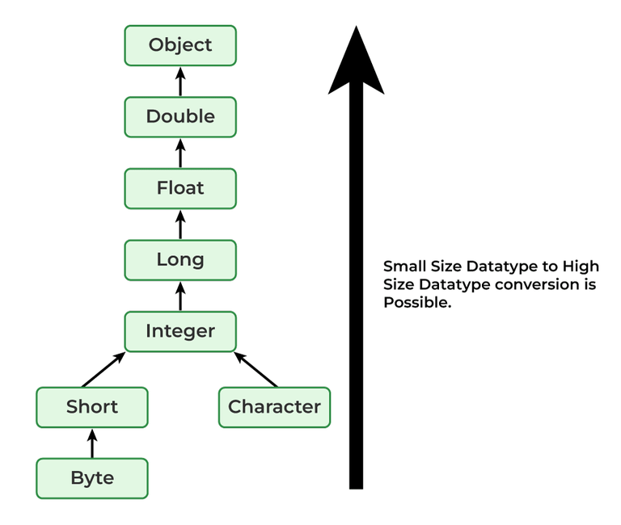
Type Conversion

Slide 20
Type Conversion
package Practice;
class Demo {
public void show(double x) {
System.out.println("In float" + x);
}
public void show(String s) {
System.out.println("In String" + s);
}
public void show(byte b) {
System.out.println("In byte" + b);
}
}

Slide 21
Type Conversion
class UseDemo {
public static void main(String[] args) {
byte a = 25;
Demo obj = new Demo();
obj.show(a);
obj.show("hello");
obj.show(250);
obj.show('A');
obj.show("A");
obj.show(7.5);
}
}

Slide 22
Recursion in java
Recursion in Java is a programming technique where a method calls itself to solve a problem.
Recursive methods are often used for tasks that can be broken down into smaller, similar sub problems.
To successfully implement recursion in Java, you need to define a base case (or termination condition) and a recursive case (or continuation condition).

Slide 23
Recursion in java
Base Case:
The base case is the condition under which the recursive method stops calling itself.
When the base case is met, the recursion stops, and the method returns a result without making further recursive calls.
Failing to provide a base case can lead to infinite recursion and a stack overflow error.

Slide 24
Recursion in java
Recursive Case:
The recursive case is the condition under which the method calls itself to solve a smaller or simpler sub problem.
Each recursive call should ideally bring you closer to the base case.
Here's an example of a simple recursive function in Java that calculates the factorial of a number:

Slide 25
Recursion in java
public class FactorialCalculator {
public static int factorial(int n) {
// Base case: When n is 0 or 1, the factorial is 1.
if (n == 0 || n == 1) {
return 1;
}
// Recursive case: Multiply n by the factorial of (n-1).
return n * factorial(n - 1);
}
public static void main(String[] args) {
int result = factorial(5); // Calculate 5!
System.out.println("Factorial of 5 is: " + result);
}
}

Slide 26
Recursion in java
In this example:
The base case is when n is 0 or 1. In this case, the method returns 1 because 0! and 1! are both 1.
The recursive case calculates the factorial of n by multiplying n with the factorial of (n-1).
When you run this program, it will calculate and print the factorial of 5, which is 120.

Slide 27
Recursion in java
Recursion is a powerful technique but should be used carefully.
It can lead to stack overflow errors if not implemented properly with a base case and appropriate termination conditions.
Additionally, excessive recursion can be less efficient than iterative solutions for certain problems.

Slide 28
Static Members in Java
In Java, static members are class-level members, which means they belong to the class itself rather than to an instance of the class.
Static members are shared among all instances of the class and can be accessed using the class name.
There are three main types of static members in Java: static variables, static methods, and static initializer blocks.
Here's how to work with them:

Slide 29
Static Members in Java
Static Variables(Class Variables):
Static variables are declared using the static keyword and are shared among all instances of the class. They are often used for constants or shared data among objects of the same class.
public class MyClass {
public static int staticVariable = 0;
}
You can access a static variable using the class name:
int value = MyClass.staticVariable;

Slide 30
Static Members in Java
Static Methods:
Static methods are also declared with the static keyword and can be called without creating an instance of the class.
They are often used for utility functions or operations that don 't depend on Instance-specific data.
public class MyMath {
public static int add(int a, int b) {
return a + b;
}
}
You can call a static method using the class name:
int sum = MyMath.add(5, 10);

Slide 31
Static Members in Java
Static Initializer Blocks:
Static initializer blocks are used to initialize static variables or perform one-time setup tasks for a class. They are executed when the class is loaded.
public class MyClass {
public static int staticVariable;
static {
// Initialize staticVariable
staticVariable = 42;
}
}
Static initializer blocks are executed once, the first time the class is loaded or a static member is accessed.

Slide 32
Use of “this “reference
In Java, the ‘this’ reference is a keyword that refers to the current instance of the class in which it is used.
It can be used in various contexts to access instance variables, call instance methods, or differentiate between instance variables and method parameters with the same name.
Here are some common uses of the this reference:

Slide 33
Use of “this “reference
Accessing Instance Variables: You can use ‘this’ to access instance variables within a class. This is particularly useful when there is a naming conflict between a method parameter and an instance variable.
public class MyClass {
private int value;
public MyClass(int value) {
this.value = value; // Use "this" to access the instance variable
}
}

Slide 34
Use of “this “reference
Calling Another Constructor:
Inside a constructor, you can use this to call another constructor of the same class. This is often used for constructor chaining.
public class MyClass {
private int value;
public MyClass() {
this(0); // Calls the parameterized constructor with a default value
}
public MyClass(int value) {
this.value = value;
}
}

Slide 35
Use of “this “reference
Returning the Current Instance: You can use this to return the current instance of the class from a method, which allows for method chaining.
public class MyClass {
private int value;
public MyClass setValue(int value) {
this.value = value;
return this; // Return the current instance for method chaining
}
}

Slide 36
Use of “this “reference
Passing the Current Object to Another Method: You can pass the current object(i.e., this) to other methods.
public class MyClass {
private int value;
public void printValue() {
System.out.println("Value: " + this.value);
}
public void performOperation() {
// Pass the current object to another method
someOtherMethod(this);
}
}

Slide 37
Use of “this “reference
Used in Inner Classes:
In an inner class, this refers to the inner class instance.
If you need to refer to the outer class instance, you can use OuterClassName.this.
public class Outer {
private int value = 10;
public class Inner {
private int value = 20;
public void printValues() {
System.out.println("Inner value: " + this.value); // Refers to inner class value
System.out.println("Outer value: " + Outer.this.value); // Refers to outer class value
}
}
}

Slide 38
Design of Accessors and Mutator Methods
Accessors and mutator methods, also known as getter and setter methods, are an essential part of object-oriented programming.
They are used to access and modify the private fields (instance variables) of a class, providing controlled access to an object's state.
Accessor Methods (Getters):
Naming Convention: Accessor methods should have names that begin with "get" followed by the name of the variable they retrieve.
The method name should be in camelCase and describe the attribute being accessed.

Slide 39
Design of Accessors and Mutator Methods
public int getAge() {
return age;
}
public String getName() {
return name;
}

Slide 40
Design of Accessors and Mutator Methods
No Arguments: Accessor methods typically do not take any arguments. They directly return the value of the associated instance variable.
Return Type: The return type of an accessor method should match the data type of the associated instance variable.
Encapsulation: Accessor methods allow controlled access to private instance variables. They enable you to hide the implementation details of your class while providing a way to retrieve its state.

Slide 41
Design of Accessors and Mutator Methods
Mutator Methods (Setters):
Naming Convention: Mutator methods should have names that begin with "set" followed by the name of the variable they modify.
The method name should be in camelCase and describe the attribute being set.
public void setAge(int age) {
this.age = age;
}
public void setName(String name) {
this.name = name;
}

Slide 42
Design of Accessors and Mutator Methods
Single Argument: Mutator methods typically take a single argument, which is the new value to set for the associated instance variable.
Return Type: Mutator methods usually return void to indicate that they don 't return any value.
Validation: You can include validation logic in mutator methods to ensure that the new value is within valid ranges or meets certain criteria.

Slide 43
Design of Accessors and Mutator Methods
public void setAge(int age) {
if (age >= 0 && age <= 150) { // Validate age
this.age = age;
} else {
throw new IllegalArgumentException("Invalid age value");
}
}

